Slide 1
Choosing the car to buy
Used American cars dataset (April – May of 2021)

Slide 2
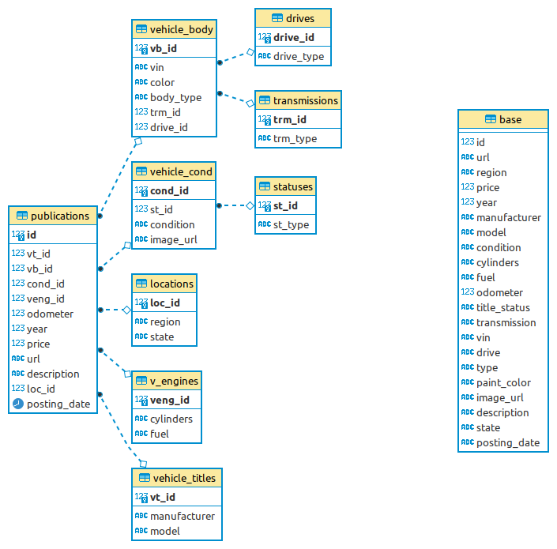
Dataset from kaggle.com
Kaggle dataset https://www.kaggle.com/austinreese/craigslist-carstrucks-data
Had in the beginning 426 880 values of the used vehicles for sale in the USA.
After cleaning it became 216 065 values, which were divided into 1 fact table(publications) and 5 (+3) dimension tables

Slide 3
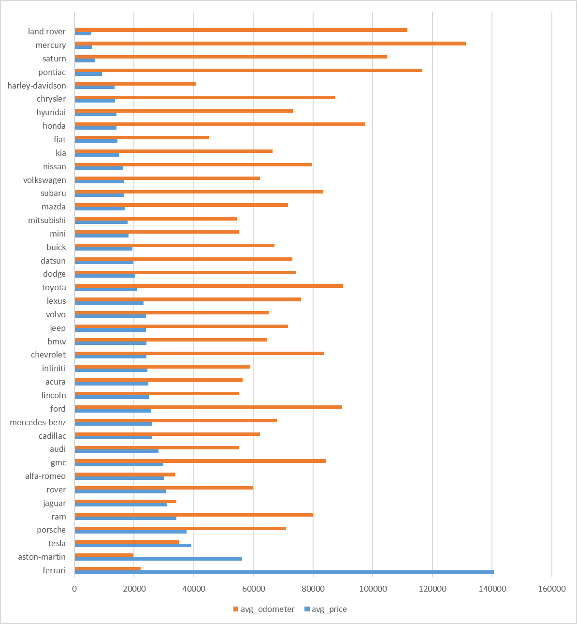
What are the average prices of the used cars market?
The average cost of the cars in the market will show how much money we should have to begin choosing car to buy.
This result shows that our budget should be not higher then 40000 dollars.
Also we see what the average odometer readings of this cars.
If to take the central part of the histogram, we will know that our car will have near 60000 miles.
And that’s why the lower budget limit we will take is near 20000 dollars.

Slide 4
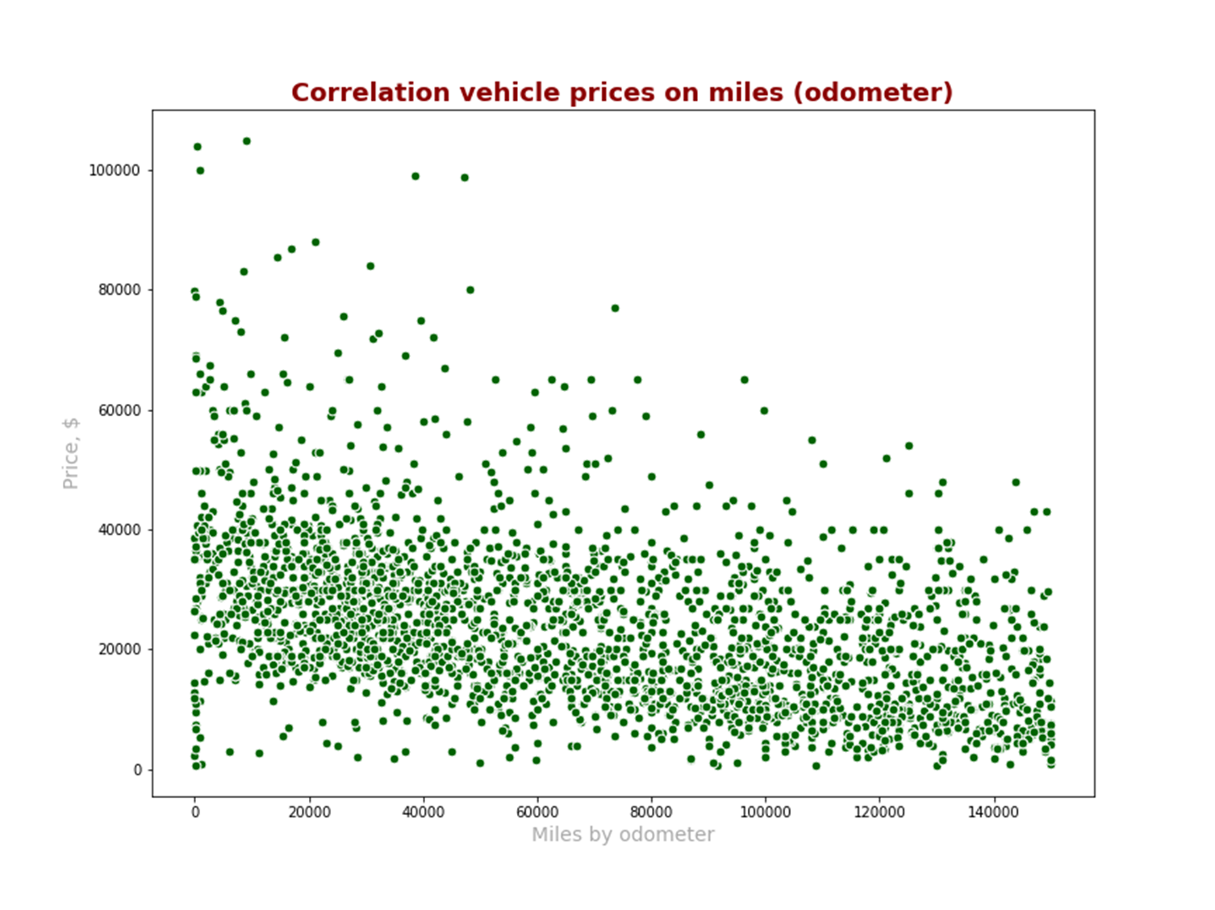
Is there a dependency of the price on the car driven miles?
We have Pearson correlation coefficient for price and readings of odometer - 0.413 – not strong negative relationship of whole cars price with their driven miles.
The more miles has driven the car, the less is the price.

Slide 5
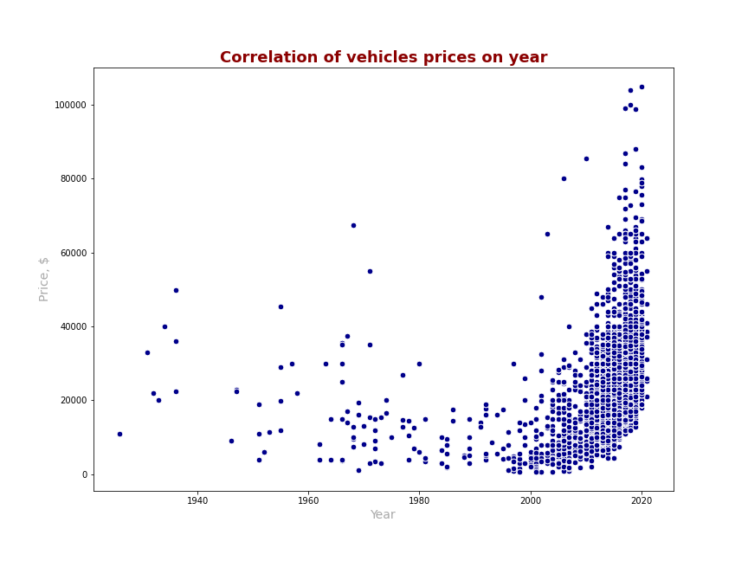
Is there a dependency of the price on the year of the car?
We have Pearson correlation coefficient for price and year of the car + 0.475 – not strong positive relationship of whole cars price with their production year.
The younger is the car, the more is the cars price.

Slide 6
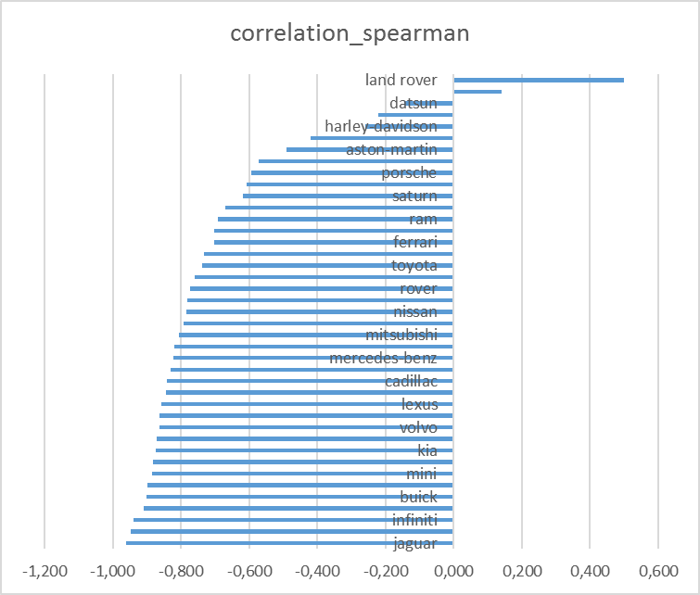
Spearman's rank correlation coefficient
To check the relationship of the price with the year of the cars (by manufacturers) I tried to calculate Spearman’s rank coefficient.
And I had the surprising result. May be it happened because of largeness of cars dataset. Ranks of the car prices were much greater then ranks of the production year.
So this coefficient has not informative results for us because it shows the negative relationship of the price with the year

Slide 7
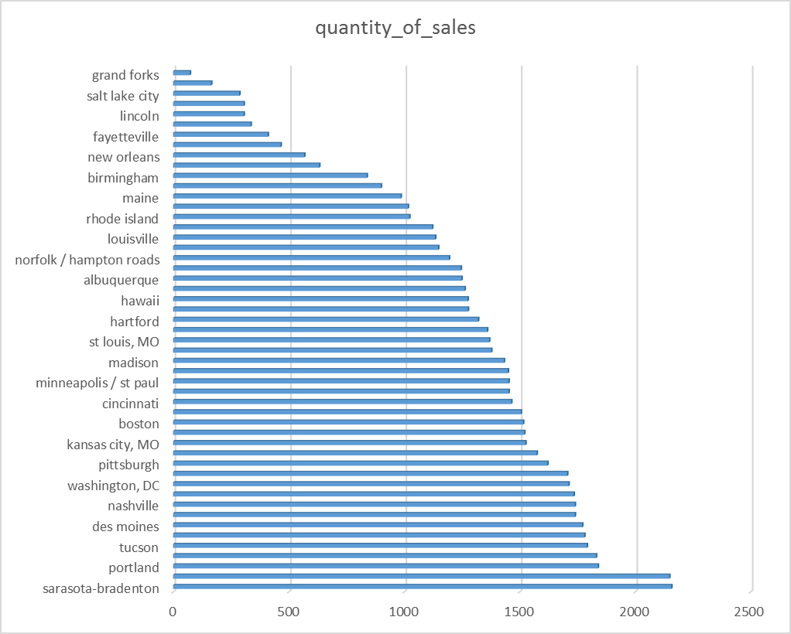
Where to go to buy the car?
The most selling regions have the best opportunities of choosing the car. The more offers, the more likely to choose the right car.

Slide 8
We choose the car with the maximum difference of it price with the average price to have the profit now and to sell it in the time.

Slide 9
Thank you for your attention!
Have a nice day!

